Slide 1






Supporting Farmworker Access to Health Care: Introduction to the Farmworker Health Network
Farmworker Health Network
February 21, 2023

Slide 2
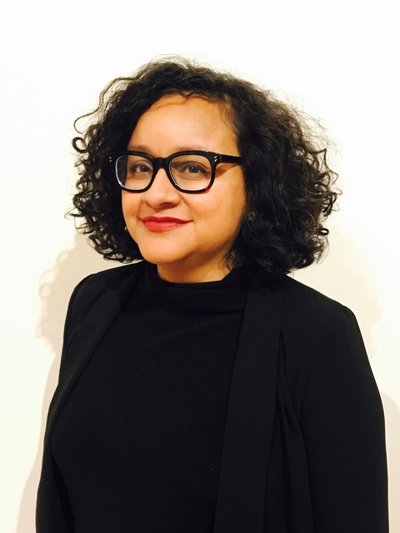

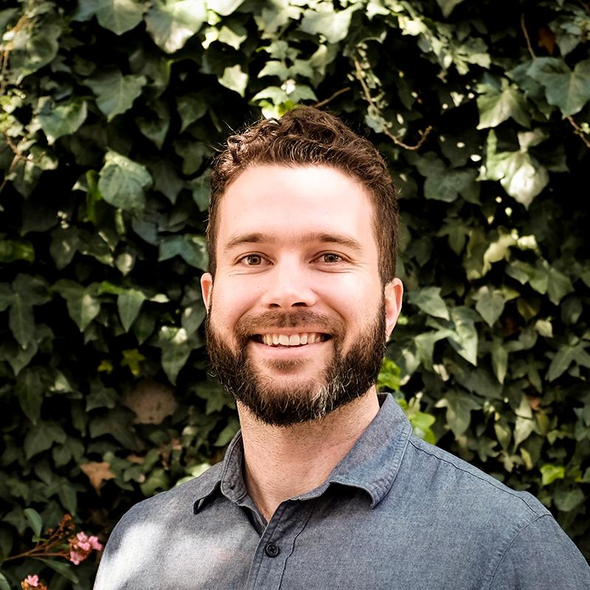



Representatives of the Farmworker Health Network
Monica Garcia
MHP Salud
mogarcia@mhpsalud.org
Alexis Guild
Farmworker Justice
aguild@farmworkerjustice.org
Liam Spurgeon
Health Outreach Partners
liam@outreach–partners.org
Jillian Hopewell
Migrant Clinicians Network
jhopewell@migrantclinician.org
Margaret Davis
NACHC
mdavis@nachc.org
Gladys Carrillo
NCFH
carrillo@ncfh.org

Slide 3
Today We Will…..
Learn about the Health Center Program
Introduce the Farmworker Health Network member organizations
Identify ways that you can connect families to health care and health information.

Slide 4
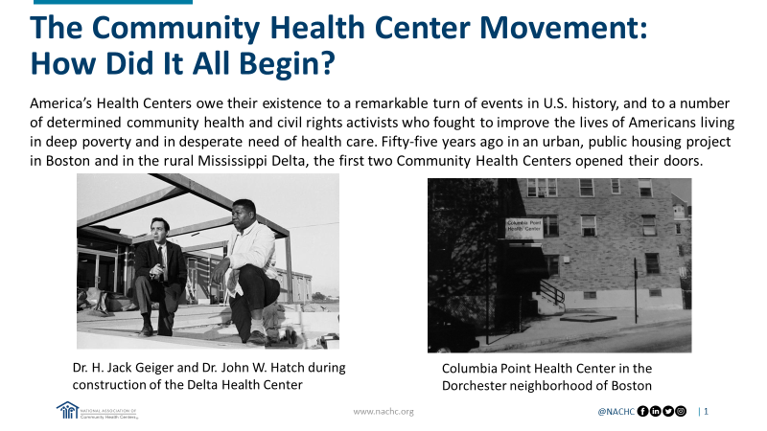

Slide 5
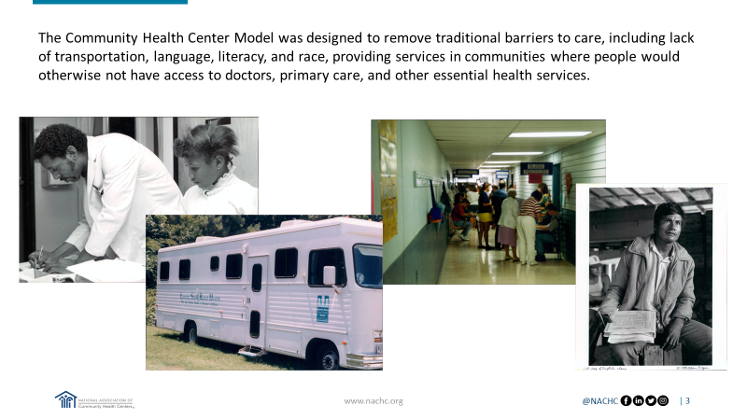

Slide 6
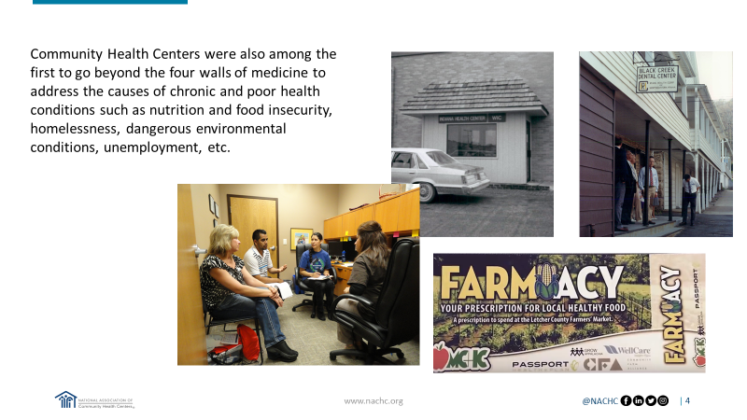

Slide 7
Health Centers….
Provide of comprehensive, culturally competent, high-quality primary health care often integrated with pharmacy, oral health, mental health and substance abuse services.
Are required to have a sliding fee scale and see all patients regardless of insurance or ability to pay.
Provide case management, transportation, and health education
Community-based and patient-directed: 51% of the health center governing board must be patients of the health center.

Slide 8
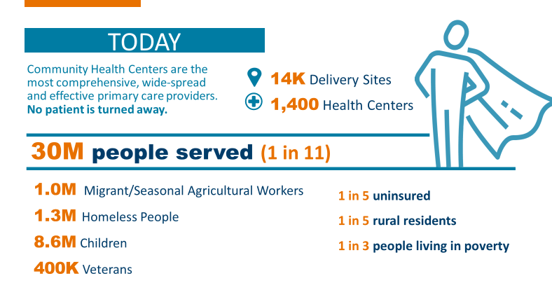

Slide 9
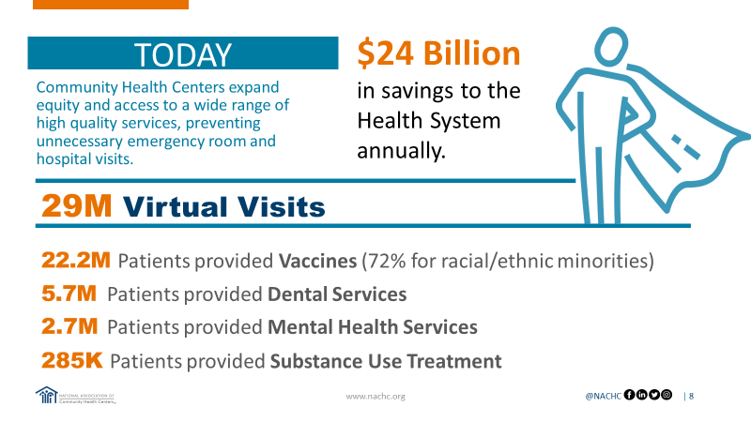

Slide 10
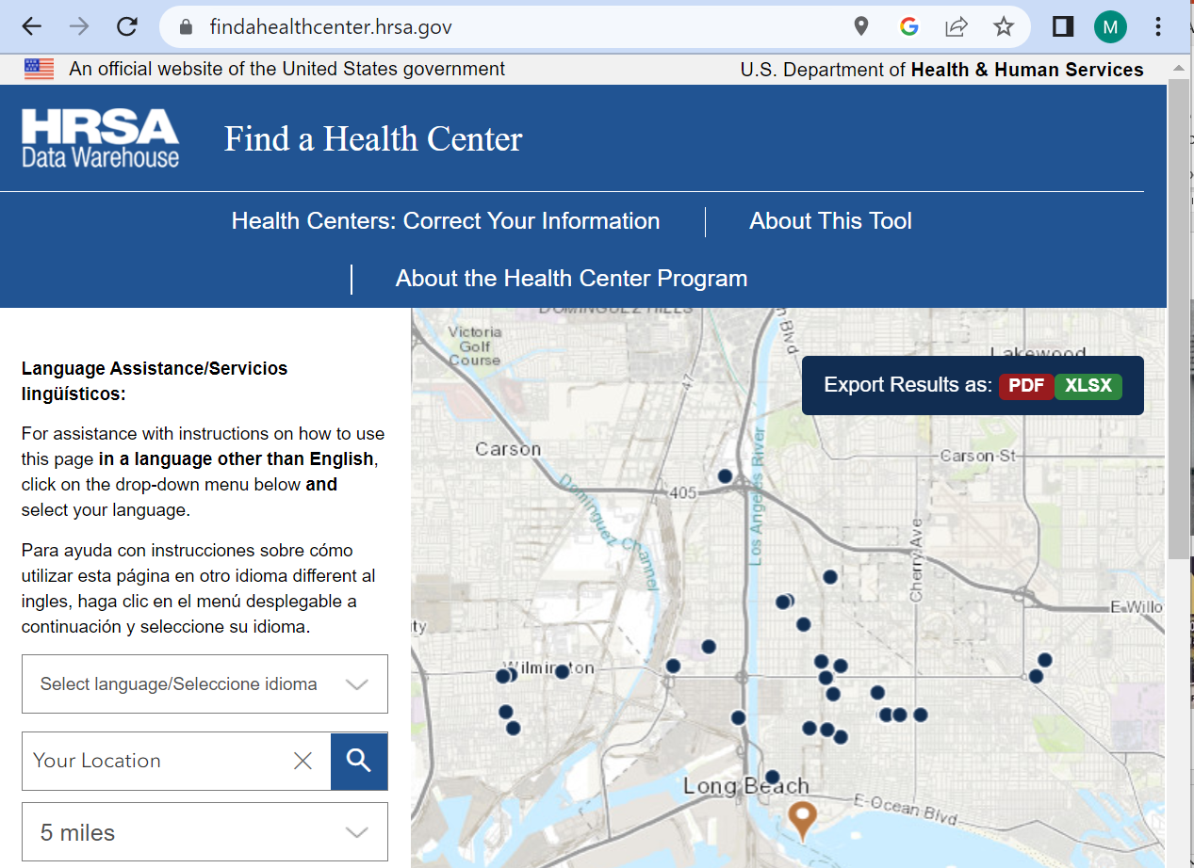
Find a Health Center
Find a Health Center helps you search for HRSA-funded health centers.
You can export results to a printable PDF file. Only the 25 closest sites will appear in the PDF export.
If you have questions, you can call the HRSA Contact Center at 877-464-4772 (TTY: 877-897-9910), 8 a.m. to 8 p.m. ET, weekdays.
Notes:
Gladys/ Alexis L

Slide 11




Farmworker
Health
Network
Notes:
The Farmworker Health Network works cooperatively with HRSA to provide training and technical assistance to over a thousand Community & Migrant Health Centers throughout the U.S.

Slide 12

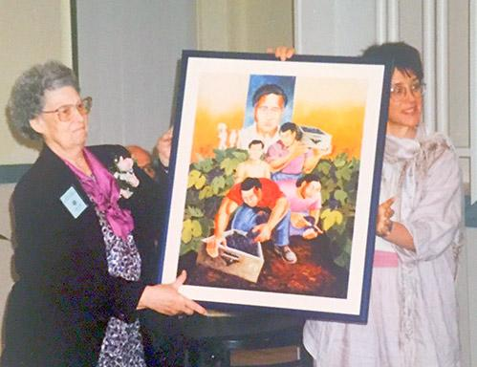
In 1983, The National Migrant Worker Council, Inc., an association of Catholic sisters, religious leaders, and volunteers formed a vision: Through collaboration and resource sharing, develop innovative health promotion programs to improve health and access to care for farmworkers and their rural communities.
“We [the founders] believed that farmworkers would listen to [their peers] about health care issues. You are always going to have… people working in the fields who feed us. We need to continue to support them to improve their lives. Respect and be grateful for the work that they do and design health promotion programs in holistic ways.”
-Sister Maurita Sengelaub, RSM
Sisters of Mercy of the Americas
Farmington Hills, MI and Founding Member of MHP Salud
Notes:
MHP Salud is a national non-profit organization that has implemented Community Health Worker (CHW) programs in underserved Latino communities for 40 years. We also promote the CHW professional nationally as a culturally appropriate strategy to improve health through national training and technical assistance opportunities.
Our roots date back to 1983 where the National Migrant Worker Council and an association of Catholic sisters had a vision to help migrant labor camps in SE Michigan.
Experienced Promotores from Midwest were invited to develop program in South and West Texas in US-Mexico border region and colonias (beyond MSAWs).

Slide 13




MHP Salud
MHP Salud is a national nonprofit organization that implements and runs Community Health Worker (CHW) programs for 40 years. We offer organizations and service providers training and technical assistance on CHW programming serving Migrant and Seasonal Agricultural Workers, older Hispanic/Latino adults, and other vulnerable populations tailored to their specific needs.
Resources
TTA
Virtual Learning
Culturally and Linguistically Appropriate materials
Blogs
Newsletters
Resources
Focus on peers/CHWs
Monthly TA Calls
TTA Requests
Training on key issues affecting Migrant and Seasonal Agricultural Workers
Webinars / Learning Collaboratives
Pre-recorded sessions
www.mhpsalud.org
Notes:
As a HRSA-Funded National Training and Technical Assistance Partner. We’ve been funded for over 25 years to provide training and technical assistance to Health Centers with Migrant Funding. We specifically offer information about using CHWs as a culturally appropriate strategy to improve health in the HRSA-identified priority areas.
Resource Development
Technical Assistance
Webinars
Learning Collaboratives

Slide 14
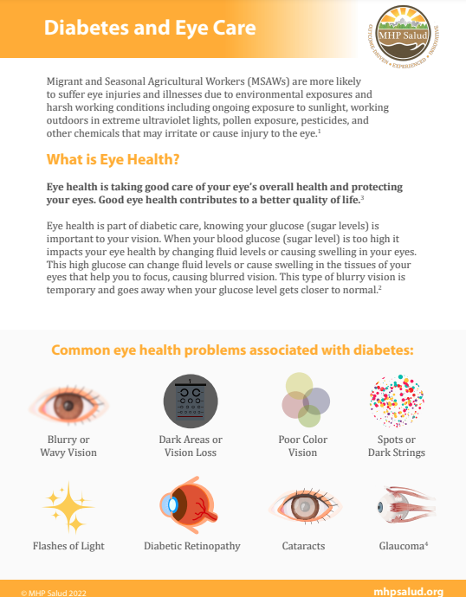
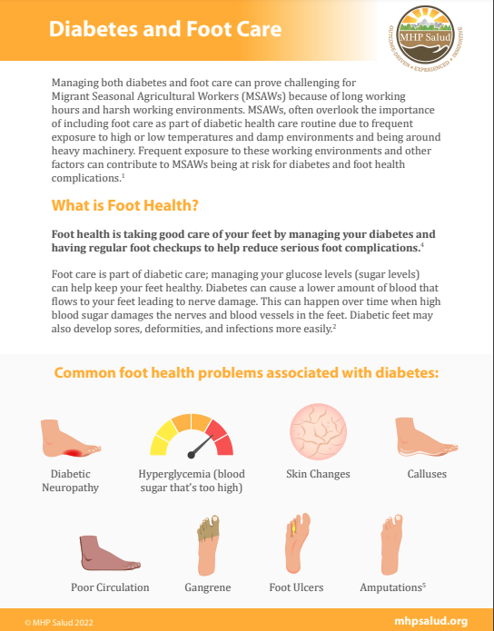

Example Resources for CHWs working with MSAWs
Educational Tools for Diabetes Control Education and Management
  Diabetes Guide
  Eye Care Guide
  Oral Care Guide
  Foot Care Guide
Notes:
Ed Tool for Diabetes Control Education and Management: 4 separate guides that CHWs can use with working with someone with diabetes to help them manage their condition as well as maintain good eye, oral and foot care. These tools show what the common health issues are and what are some ways to stay healthy.
https://mhpsalud.org/portfolio/diabetes-control-education-management-guide-for-community-health-workers/

Slide 15

MHP Salud
Monica Garcia
Health Strategy Specialist
mogarcia@mhpsalud.org
Notes:
www.mhpsalud.org

Slide 16

Farmworker Justice (FJ)
Farmworker Justice seeks to empower farmworkers and their families to improve their living and working conditions, immigration status, health, occupational safety, and access to justice.
Using a multi-faceted approach, FJ engages in litigation, administrative and legislative advocacy, training and technical assistance, coalition-building, and public education

Slide 17
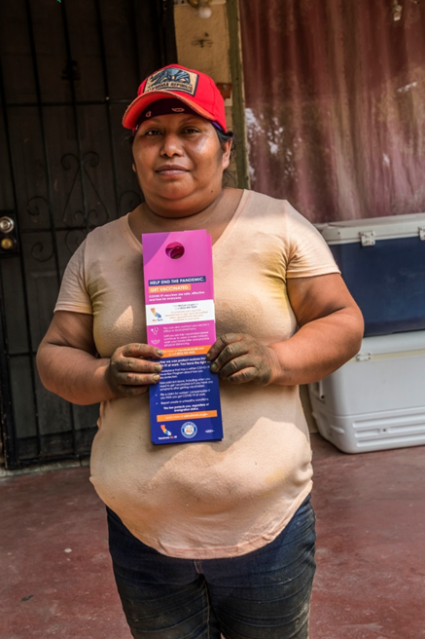

Farmworker Justice (FJ) Training & TA
Promotes utilization of health care services, access to health care, and occupational safety and health of farmworker families
Policy-information sharing on occupational, environmental health and health care
Community-collaborations/partnerships
Community-based health promotion projects - skin cancer patient navigation, heat stress, health insurance, workplace harassment

Slide 18
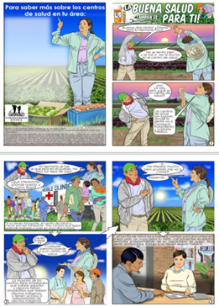
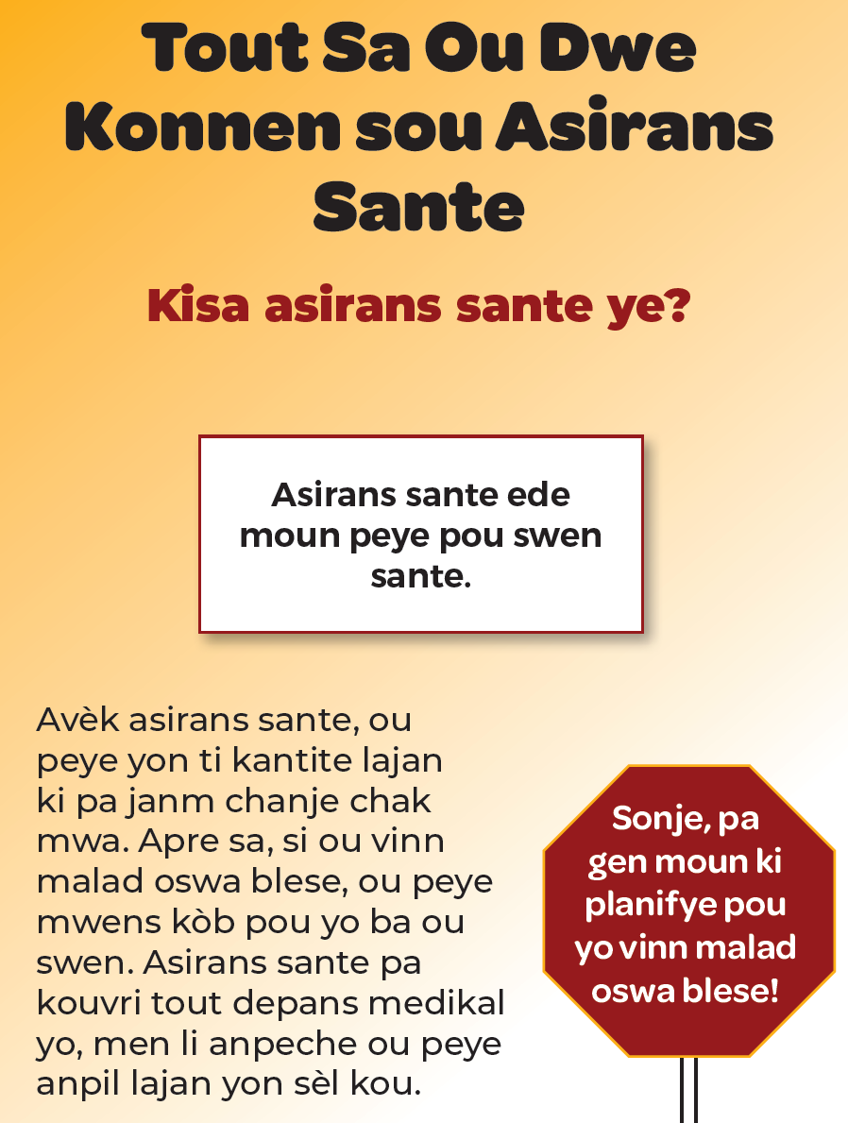

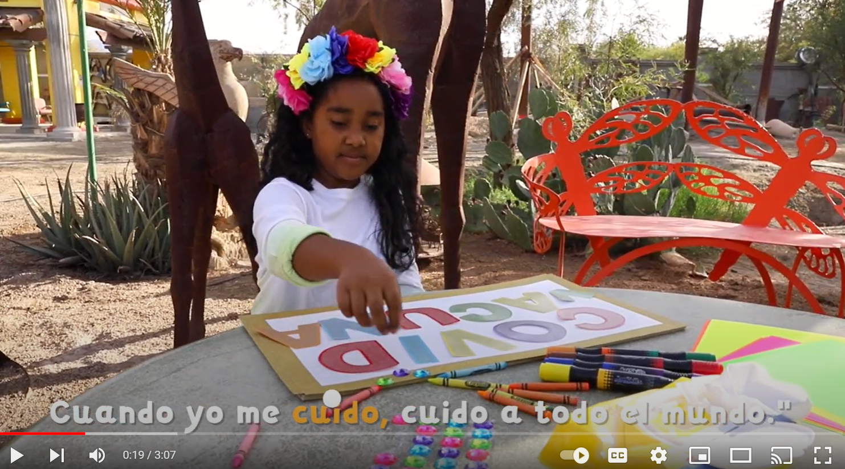
Farmworker Justice (FJ) Resources
Training of trainers curricula
Educational materials for workers and their families (English, Spanish, Haitian Creole, indigenous languages)
Topics: COVID-19, health centers, health insurance, diabetes, healthy eating, skin cancer, heat stress, worker safety (dairy, pesticides)

Slide 19
Farmworker Justice (FJ)
Website - www.farmworkerjustice.org
Youtube - https://www.youtube.com/@farmworkerjusticeyoutubech1786
Alexis Guild, Director of Health Policy and Programs
aguild@farmworkerjustice.org

Slide 20

Health Outreach Partners (HOP)
  TEXT

Slide 21

Health Outreach Partners (HOP) Training/TA
Services offered: Consultation, Training, Workshops, Learning Collaboratives, Webinars
Resources offered: Toolkits and Starter Kits, Manuals, Articles, Innovative Outreach Practices & Case Studies
Topics covered:
  Diversity, Equity, and Inclusion (DEI) Assessment
  Organizational Self-Care
  Program Planning and Evaluation
  Structural Competency
  The Business Value of Outreach (OBV)
  Transportation Barriers
  and many more!

Slide 22
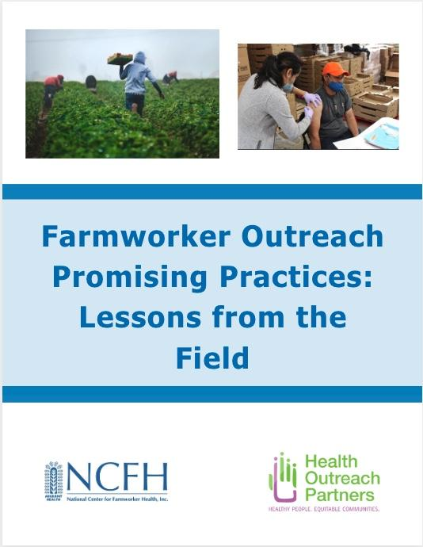

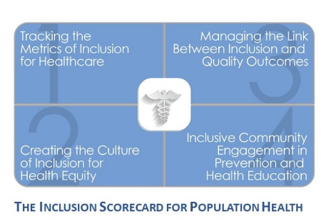
HOP Recent Highlighted Resources
DEI Assessment Tool: Inclusion Scorecard for Population Health
Podcast Series on the Impact of COVID-19
Farmworker Promising Practices from the Field

Slide 23


Health Outreach Partners Contact
Liam Spurgeon, Program Director of HRSA Programs & Communications
Contact: liam@outreach-partners.org; 510-268-0091x704
www.outreach-partners.org

Slide 24
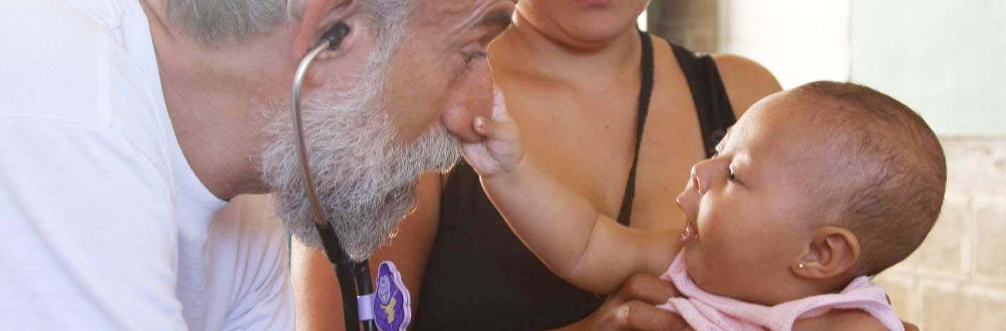

Our mission is to create practical solutions at the intersection of vulnerability, migration and health
A force for health justice
We envision a world based on health justice and equity, where migration is never an impediment to well-being.
Somos una fuerza dedicada a la justicia en salud

Slide 25



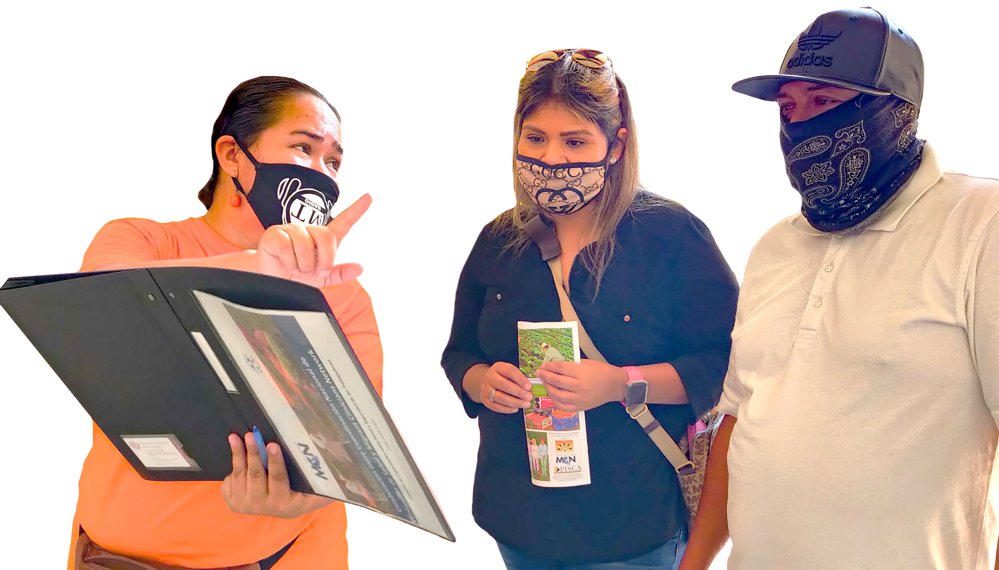


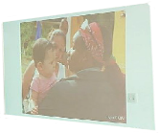




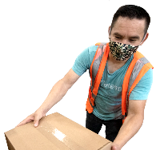


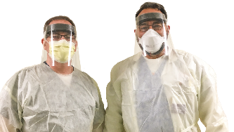
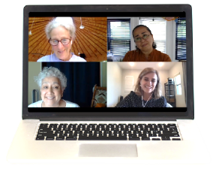
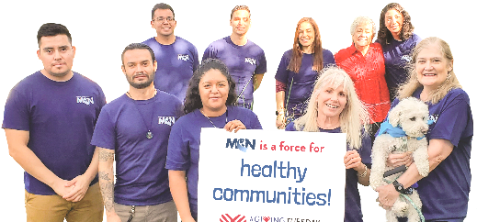
Our Work
Resource
Development
Technical Assistance
VdS San Bernardino
Bridge Case
Management
Education
Research
Worker Health and Safety
Psychosocial Support for Providers
Peer
Networking
Evaluation
Advocacy

Slide 26
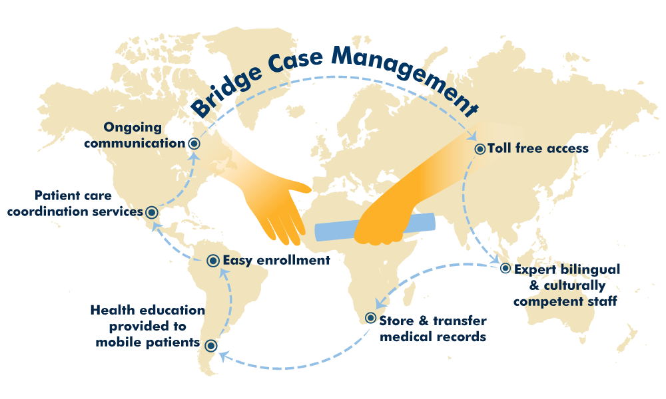
MCN’s Health Network provides continuity of care to mobile patients and their providers
Notes:
One of our oldest programs, 25 years ago, is that of the Health Network or Helath Network. Where we serve as a bridge for health case management, providing continuous communication between the patient and the health care provider through coordinating services between the patient and the health center or provider, providing the service of hosting the medical records of mobile or migrant patients. Patients register with this system and consent to their files following them virtually as they change their residence. It is a free service, the patient has access to free phones to notify that he needs certain services and that we help them manage them in order to finish a treatment

Slide 27
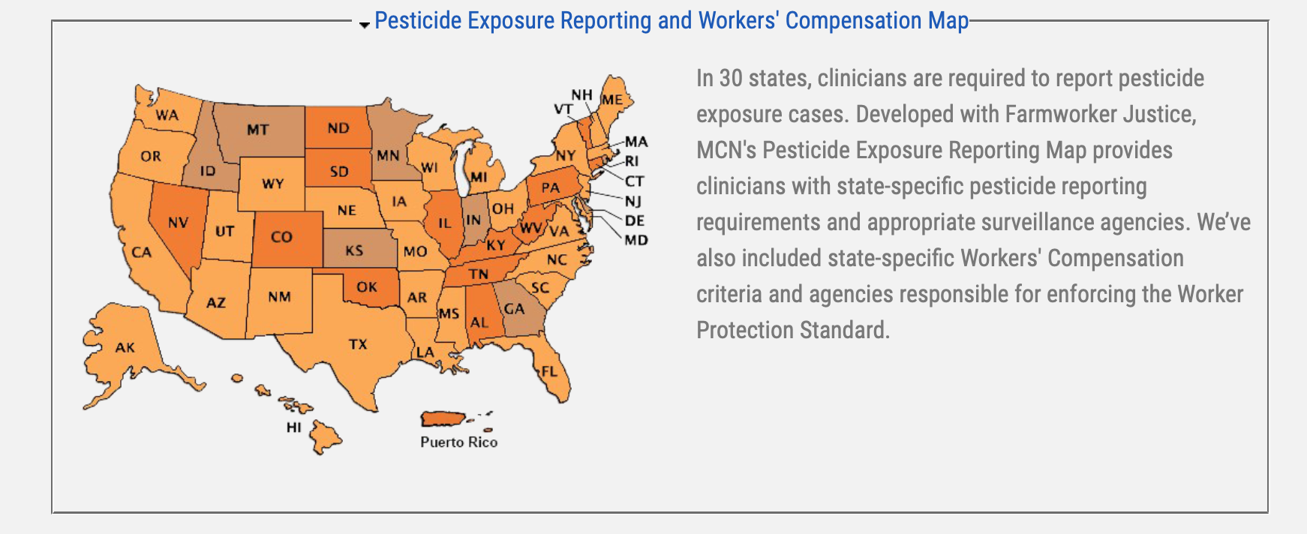
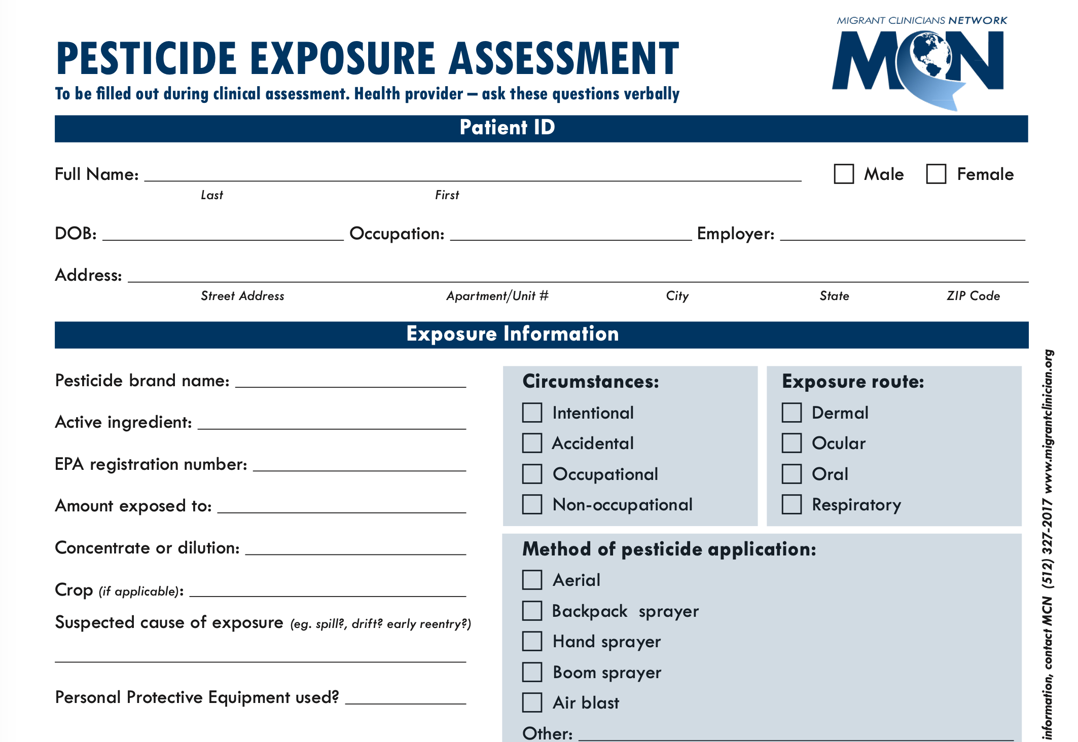
Integrate worker health into primary care
Community Health Centers are point of entry into the health care system.
Improve recognition, management and prevention of work-related exposures, injuries and illnesses.
Develop clinical systems to support documentation, management and reporting.

Slide 28







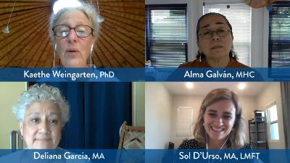




Connect with
!
Access our
latest resources
Get updates from the field
Attend our virtual trainings
and a lot more at
www.migrantclinician.org
@tweetMCN
|
@migrantclinician
|
@migrantcliniciansnetwork

Slide 29



Slide 30


NACHC Provides
NACHC provides health centers with live trainings as well as on-demand learning and resources
NACHC administers the Health Center Resource Clearinghouse that hosts hundreds of resources from 21 National Training and Technical Assistance Partners
Healthcenterinfo.org

Slide 31
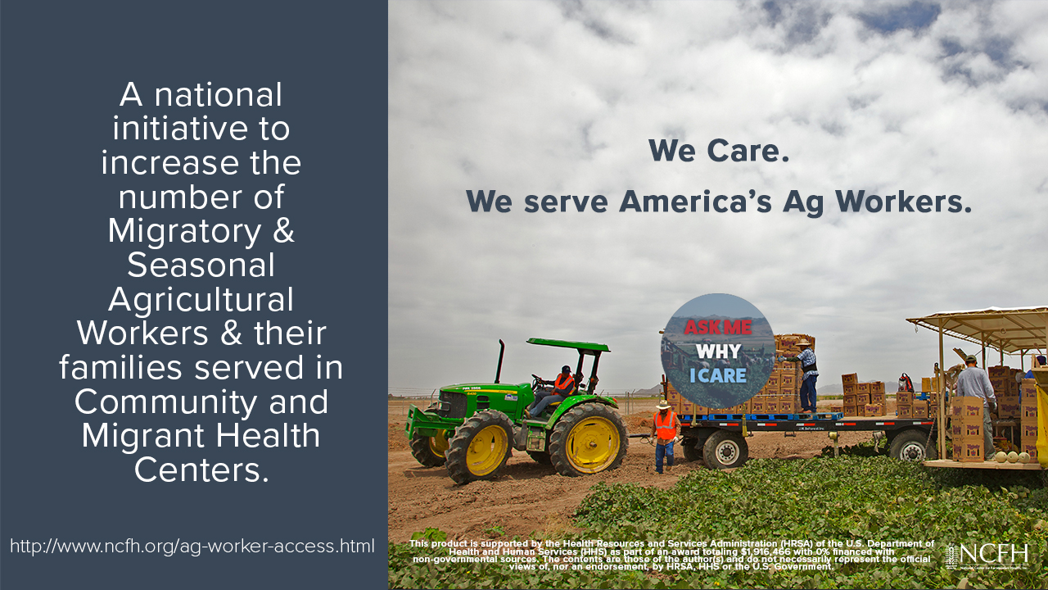
National Center for
Farmworker Health
The National Center for Farmworker Health is a private, not-for-profit organization located in Buda, Texas, whose mission is
“To improve the health of farmworker families.”
Notes:
Gladys

Slide 32
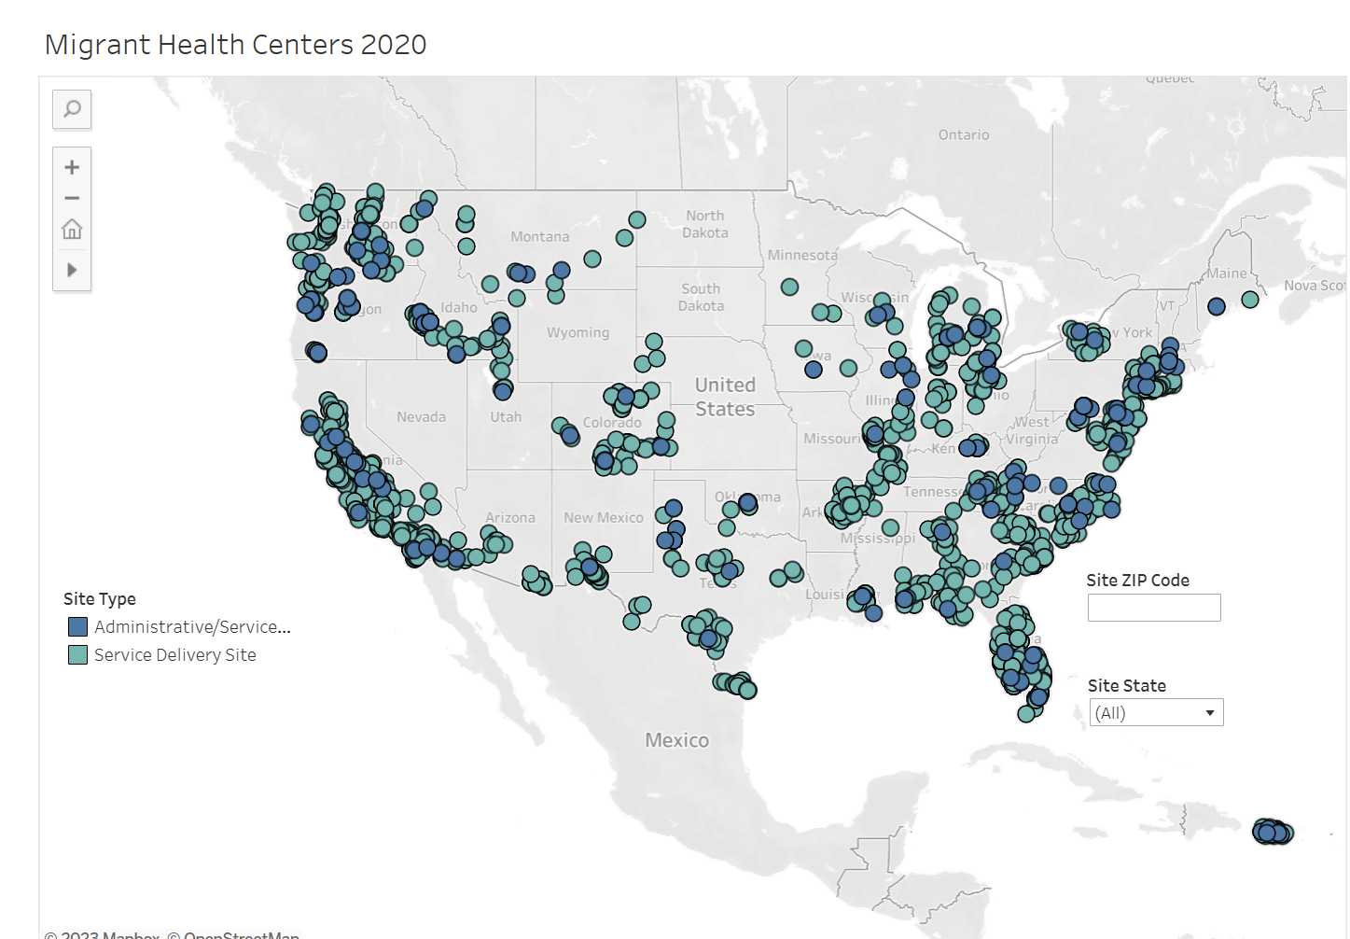


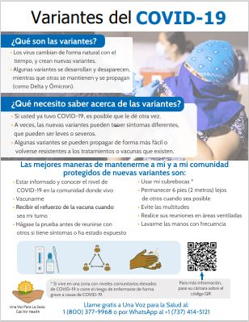
National Center for
Farmworker Health
Patient Health Education, Resource Hubs, & Digital Stories
Population Specific Data, Research, & Factsheets
COVID-19 Resources & Call for Health
Notes:
Gladys
Population specific data resources and technical assistance (Pop Estimation, Factsheets & research)
Patient Health education Materials, Resource Hubs, & Digital stories
COVID-19 Resources for Ag workers, employers, CBOs,
Call For Health Program (national lifeline available for FWs to connect them to HCs, provides some financial assistance, interpretation assistance, and community referrals

Slide 33



National Center for
Farmworker Health
Workforce Development & Learning Collaboratives
Governance Training, Tools, & Strategic Planning
MWSF & Regional Stream Forums
Notes:
Gladys
Workforce development and training (Learning Collaborations, archived webinars, HC toolbox)
Regional Stream Forums (Eastern, Western, MWSF)
Governance Training, tools, and strategic planning (Governance SP modules, LC templates for P&P, strategic planning)
Program Development and Management

Slide 34







National Center for
Farmworker Health
Gladys Carrillo, LCSW
Director of Program Services
carrillo@ncfh.org
Facebook and Twitter: @NCFHTX
Instagram: @Farmworkerhealth
YouTube: National Center for Farmworker Health
Linkedin: company/national-center-for-farmworker-health-ncfh-/
Notes:
Gladys
NCFH News
Boletin de Sol a Sol

Slide 35
Q&A Discussion
We will now address your questions!
Notes:
Proceed to the Q&A session. Open for all FHN representatives to answer.

Slide 36
Webinar Evaluation

Slide 37

Thank you for attending today’s webinar!
Farmworker Health Network
Notes:
Thank you for joining us this afternoon.

